Slide 1
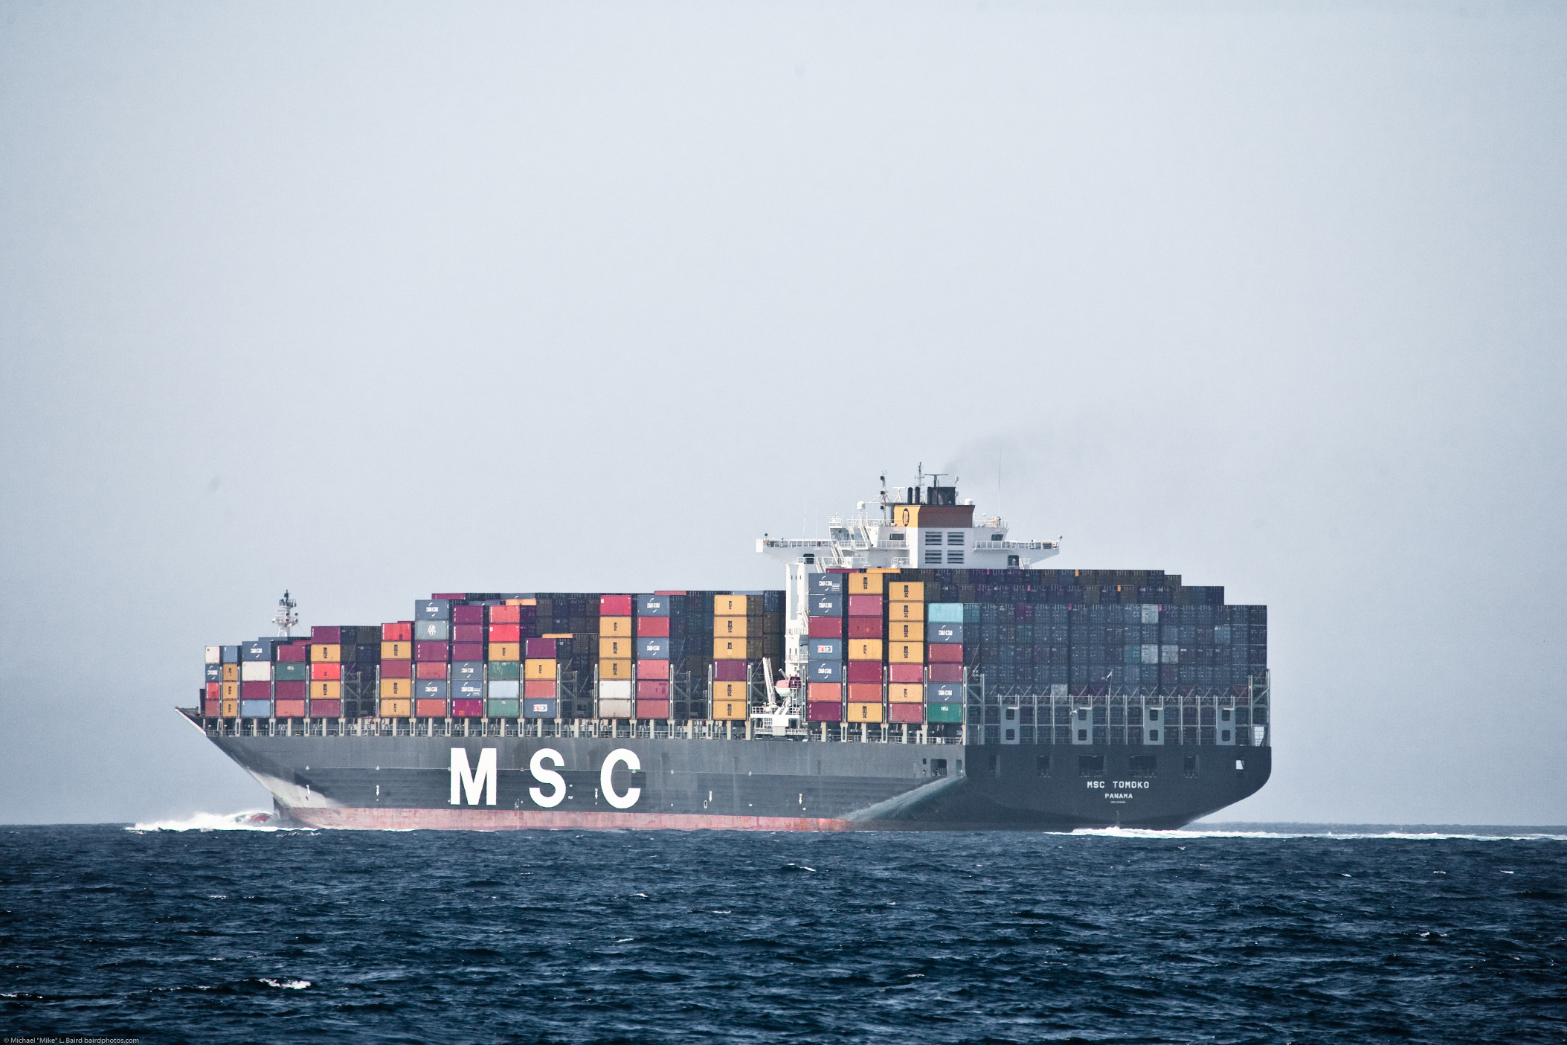
Assessing Ship Movements Using Volunteered Geographic Information
Shaun Walbridge
walbridge@lifesci.ucsb.edu
Image Credit: Mike Baird, flickr.com/photos/mikebaird
Notes:
Hi, I'm Shaun, a masters student in EEMB, and for my thesis work I'm studying global shipping. Shipping has huge ecological implications, but we have very little useful data, and I'm working to produce the data that fills this gap.
MSC Tomoko Panama in the Santa Barbara channel, almost 4 football fields long, 8400 containers each 20 feet in length.

Slide 2
Goals
Background on ship data
Fusing volunteered data
Cover relevant Ecological models: strikes, noise, groundings
The future: networks

Slide 3
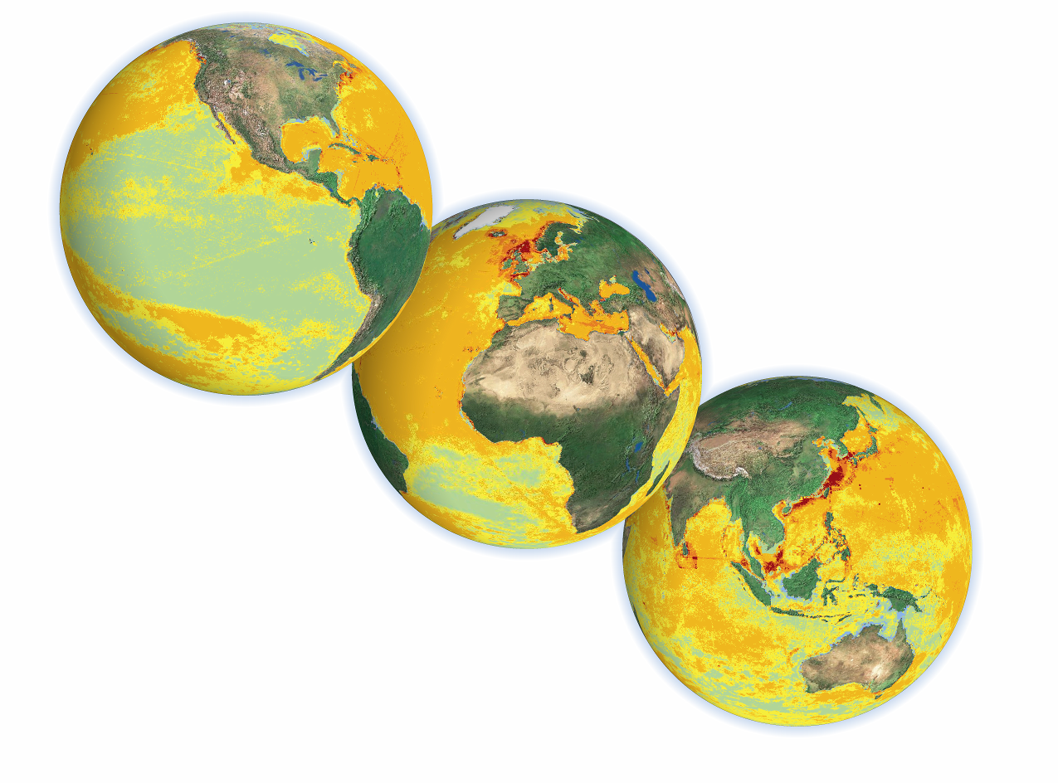
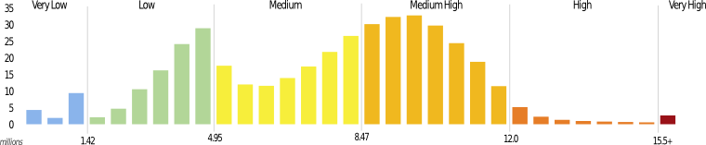
Halpern et al, 2008
Notes:
Why shipping? A few years ago, I worked along side Ben Halpern and many other scientists looking at the cumulative human impacts to the marine environment. We addressed 17 threats and looked at how they effected 20 different habitat types, and this map is the result.

Slide 4
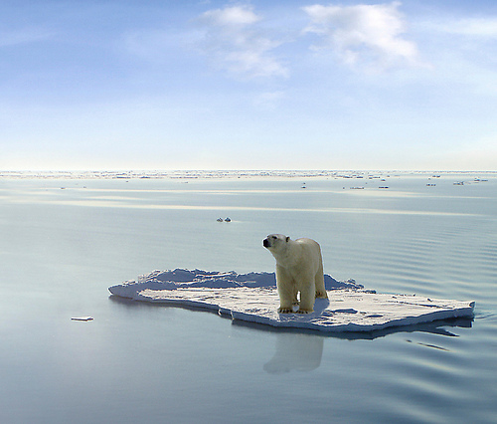
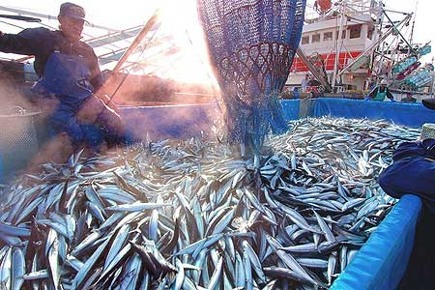
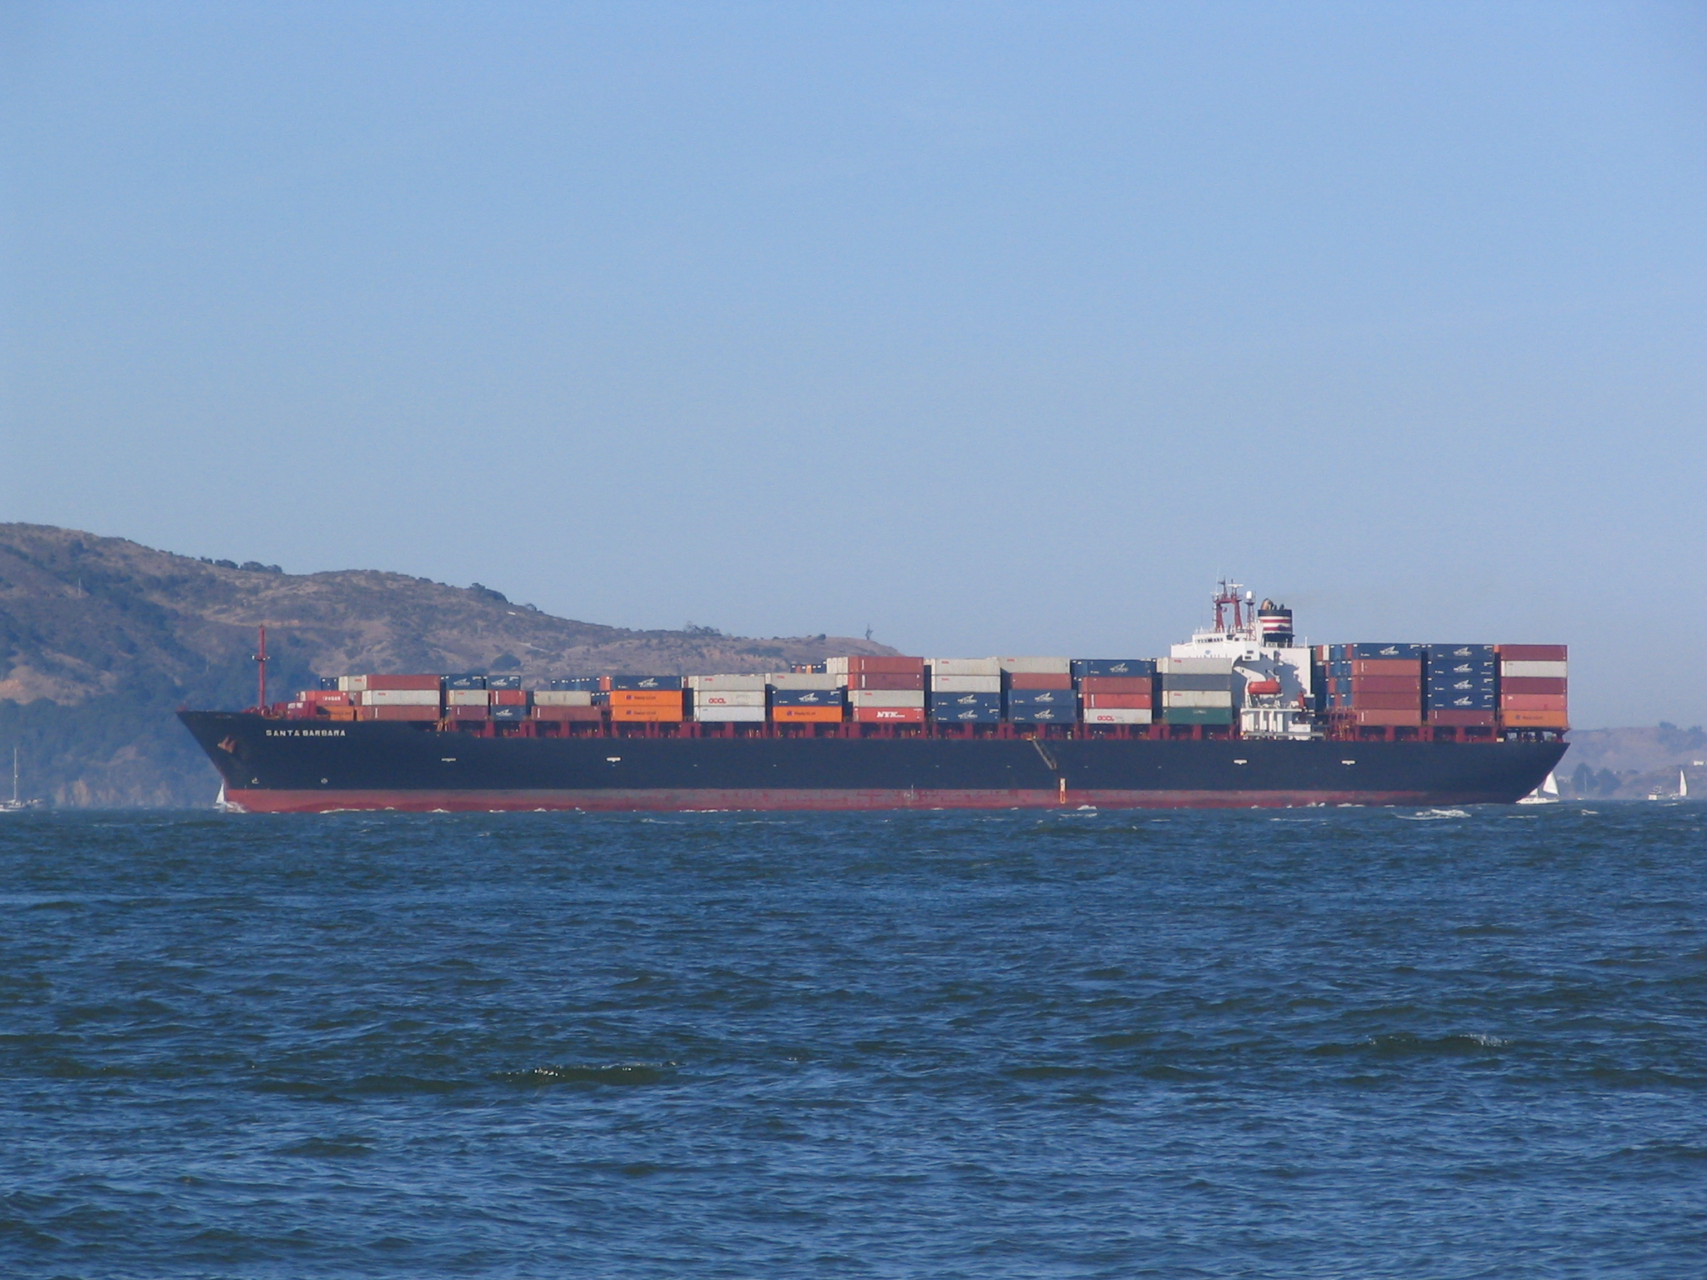
The largest cumulative impacts:
Daily Yimuri
Fishing
G.Van der Leun, goo.gl/bqIuA
Climate Change
Shipping
Peter Kaminski, goo.gl/GpTS0
Notes:
We discovered that three groups of threats really drive the system. Climate change and Fishing are broad fields within science, but shipping is a niche mostly occupied by logistics and defence people, not ecologists.

Slide 5
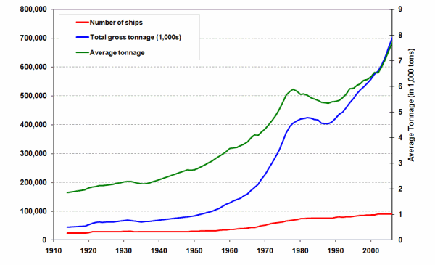
Maritime Trade
90% of global trade
volume
$1.8T of goods in '08
Baltic Dry Index a leading economic indicator
Data is valuable ($)
Lloyds of London, 2007
Notes:
Economics. Big valuable market, so folks like Lloyds charge through the nose for access.
Tied to globalation, and continues to grow rapidly.

Slide 6
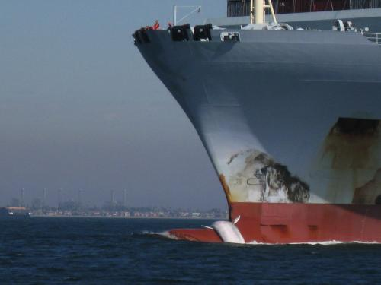
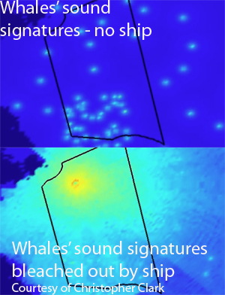
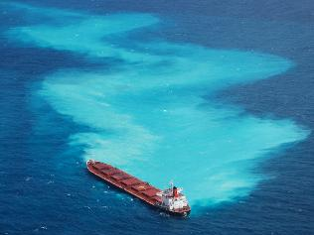
Ecological Effects
Invasive Species ballast water
Emissions 5% global GHG, 25% NOx; 60,000 deaths yr-1
Direct Pollution sewage, marine debris, gray water
Ship Strikes
Noise Pollution
Ship Groundings
Murray Ware
Maryland DNR
Notes:
Here's a few of the major ecological effects:
Ship strikes on the right whale are the predominant factor of premature mortality with that species, lots of good work trying to incorporate shipping into how we manage the species
Noise pollution, shipping is the main source of chronic noise.
Groundings, from the Great Barrier Reef to Exxon Valdez are a major concern.
What data do we have to understand shipping?

Slide 7
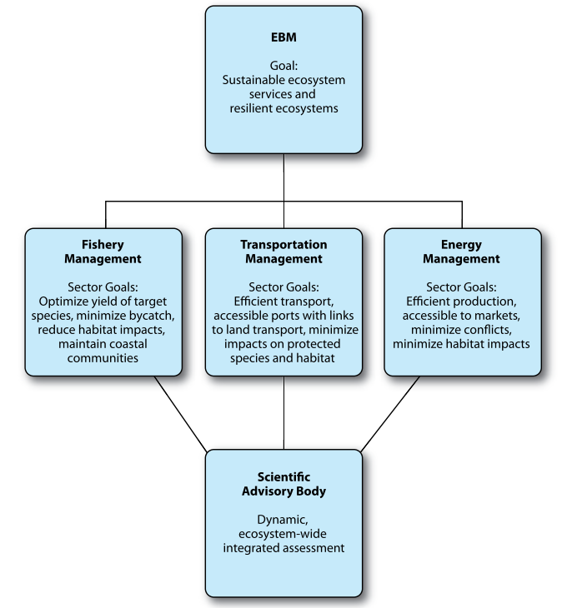
Lubchenco et al, 2010
Notes:
Shipping is also important in a broader context, as move toward holistic management of the oceans. To do effective Ecosystem-based management, we need foundational data on anthropogenic use, and we have little information on shipping.

Slide 8
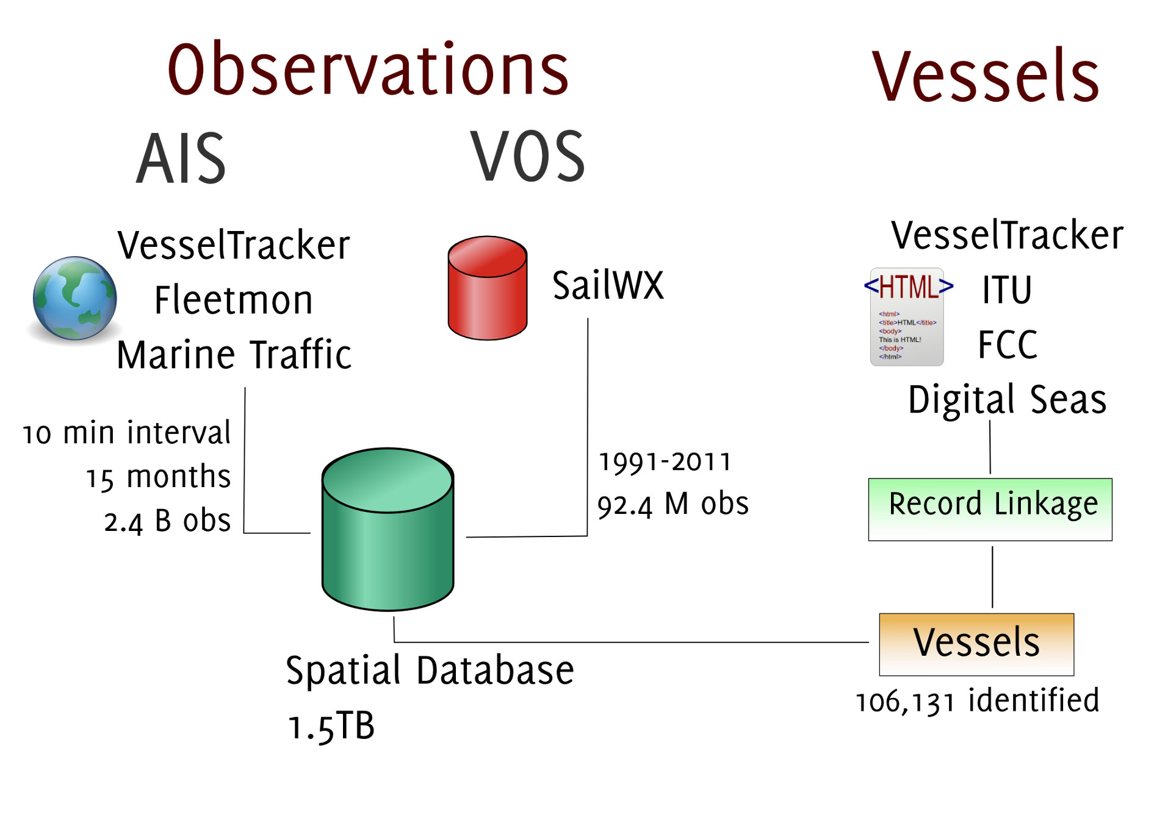
Data Fusion Workflow

Slide 9
Data Fusion Workflow

Slide 10
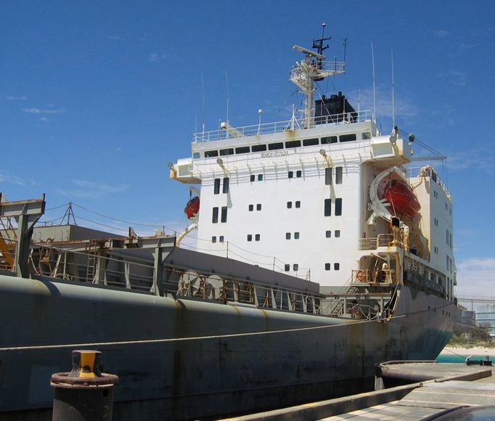
Voluntary Observing Ship (VOS) Fleet
Intent is ocean climate
Volunteered, 5–15% of ships
No ship type in 56% of records
Here, records from 1991-2011 used

Slide 11
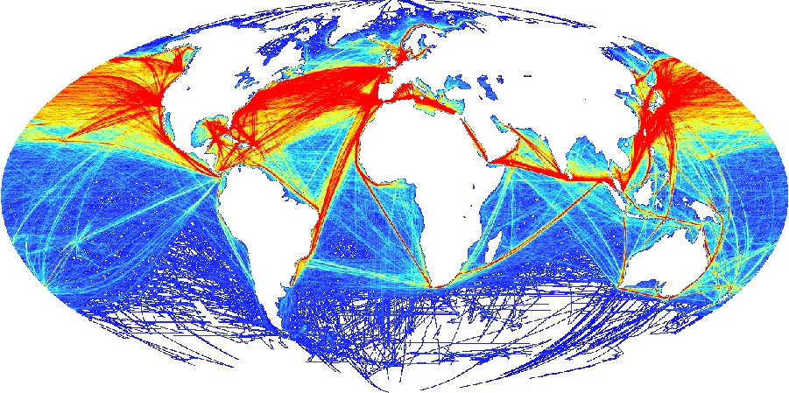
Pretty map, pretty poor for analysis
Notes:
It makes a pretty picture, but it really just connects the dots between observations, including through the middle of landmasses. Need something better to address questions of the ecological effects.

Slide 12
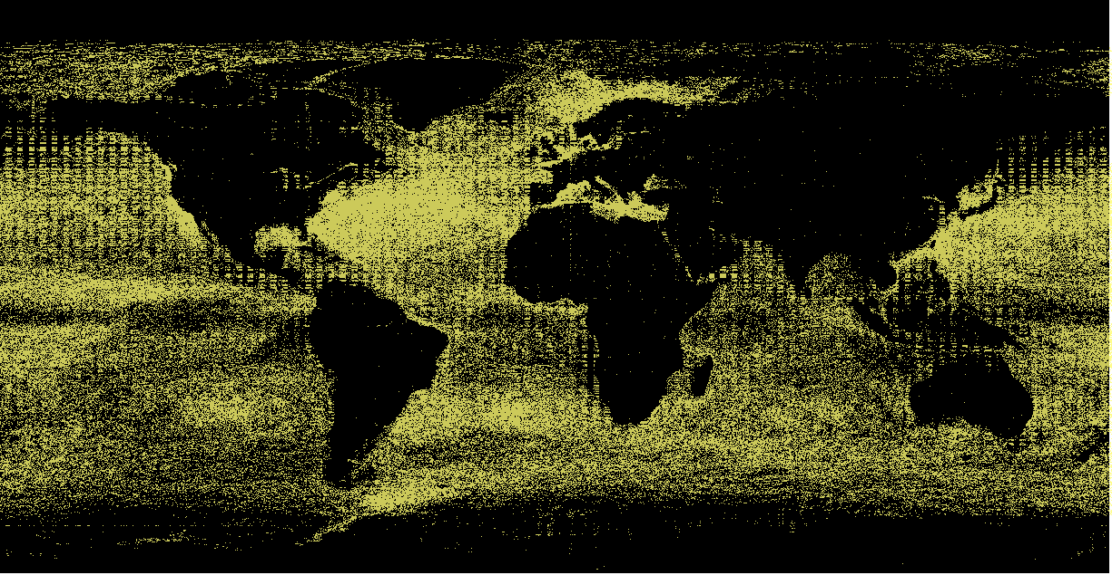
VOS: 2003-2011, 68.8m
Notes:
PRESENCE-ABSENCE map, cells that are lit up had at least one visit during the 8 year window of the data. Broad coverage, but difficult to discern patterns.

Slide 13
Automatic Identification System (AIS)
GPS based, high spatial accuracy (~10m) and high temporal frequency
Mandated on large vessels and passenger ships
Intent is safety
Radio based, real-time
Attributes: ship id (x,y) heading type
speed
IMO
Notes:
LIVING RESOURCE improving over time, and has realtime observations, can we move toward ecologically based navigation systems?

Slide 14
AIS: Nov, 2011
Green: Fishing 6.8m
Blue: Tankers 31m
Red: Cargo 48m
Notes:
All of our AIS observations in November 2011
This also illustrates some of the challenges of Volunteered information – notice the cluster of observations in the mountains of southeast Algeria

Slide 15
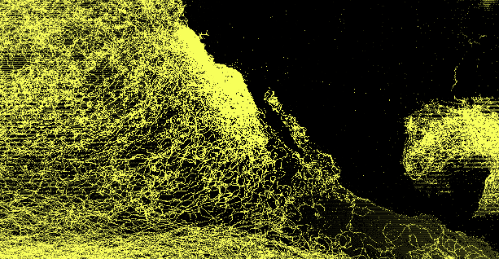
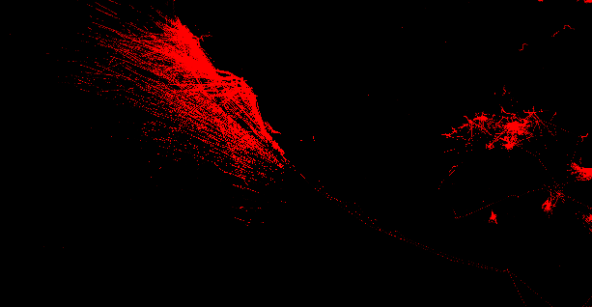
VOS: 2003-2011
AIS: Cargo Ships
Nov, 2011
Notes:
VOS includes scientists on research vessels, who not known to take the shortest route to their goals, and can be seen moving in irregular patterns within the data.
Contrast this with the AIS data for only cargo ships, immediate patterns jump out.

Slide 16
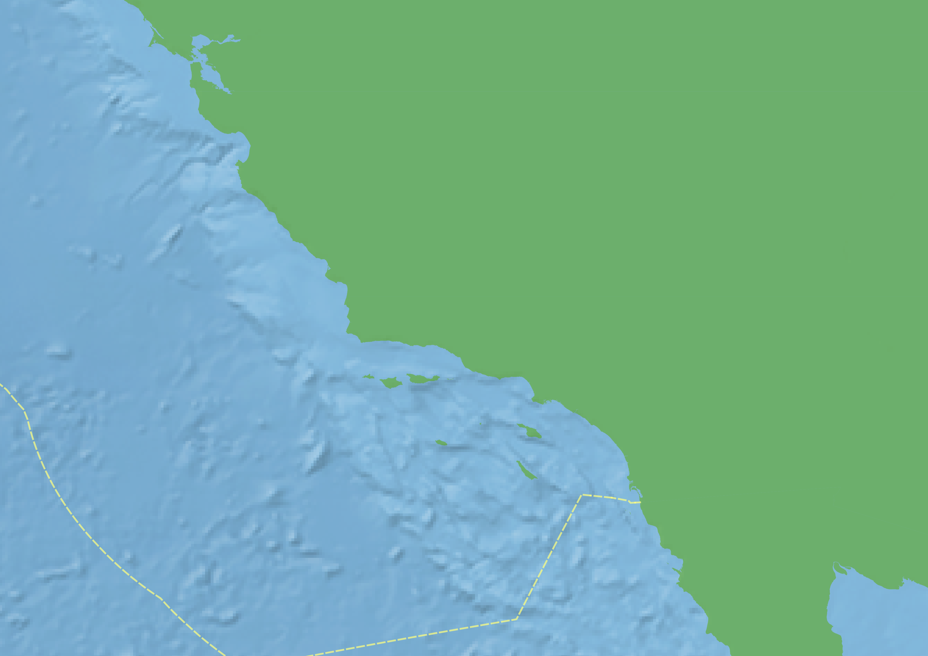
AIS Density Maps
Nov 2010-Dec 2011

Slide 17
Authority

Slide 18
Cargo
Maersk may use
channel, most don't

Slide 19
Passenger

Slide 20
Fishing

Slide 21
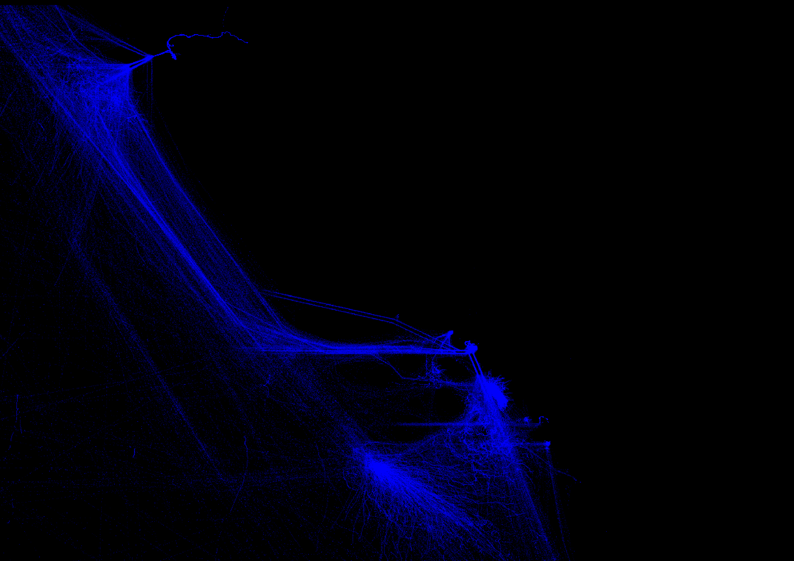
Tankers

Slide 22
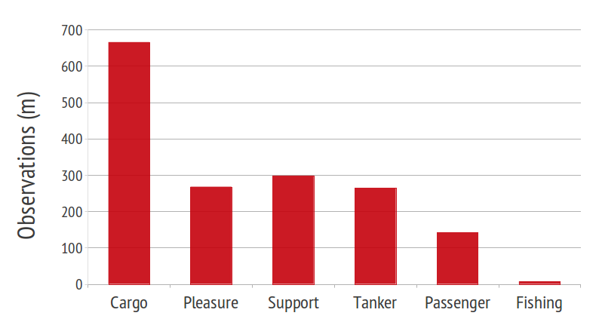
Fused Data
Observations (426 GB): - AIS: 2.37 Billion, 15 months, 2010-2011 - VOS: 92.4 Million, 1991-2011
Related data: 200,000 vessels, 5,000 ports
Linkage of records across datasets
AIS: Nov 2010-Dec 2011
Notes:
Use 'big data' approaches to manipulate the large volume of data

Slide 23
Data Fusion Workflow

Slide 24
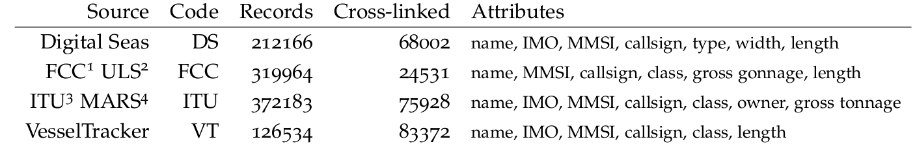
Ship Records
Want to know: which vessel is this? What kind?
Attributes useful for ecological questions:
Noise: engine type, length, type Ballast: type, length Strikes: Maximum speed, type, draft

Slide 25
Ship Records
Record Linkage: Use fuzzy reasoning to cross-link records from differing sources Probabilistic pairwise combinations between source pairs: 205,030 linked pairs. Merged pairs into validated individual vessels, AND link our observations to these records

Slide 26
Vessel Speeds by Type

Slide 27
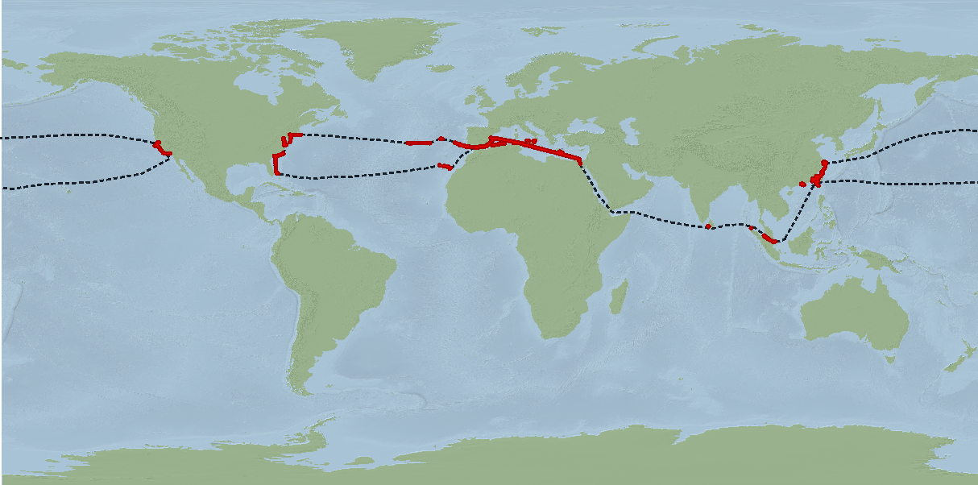
Vessel Movement Models
Notes:
Revisiting the ship from our first slide, with AIS data, where has TOMOKO traveled in the last year? We want to make inference about how it moved inbetween the times we have observations.

Slide 28
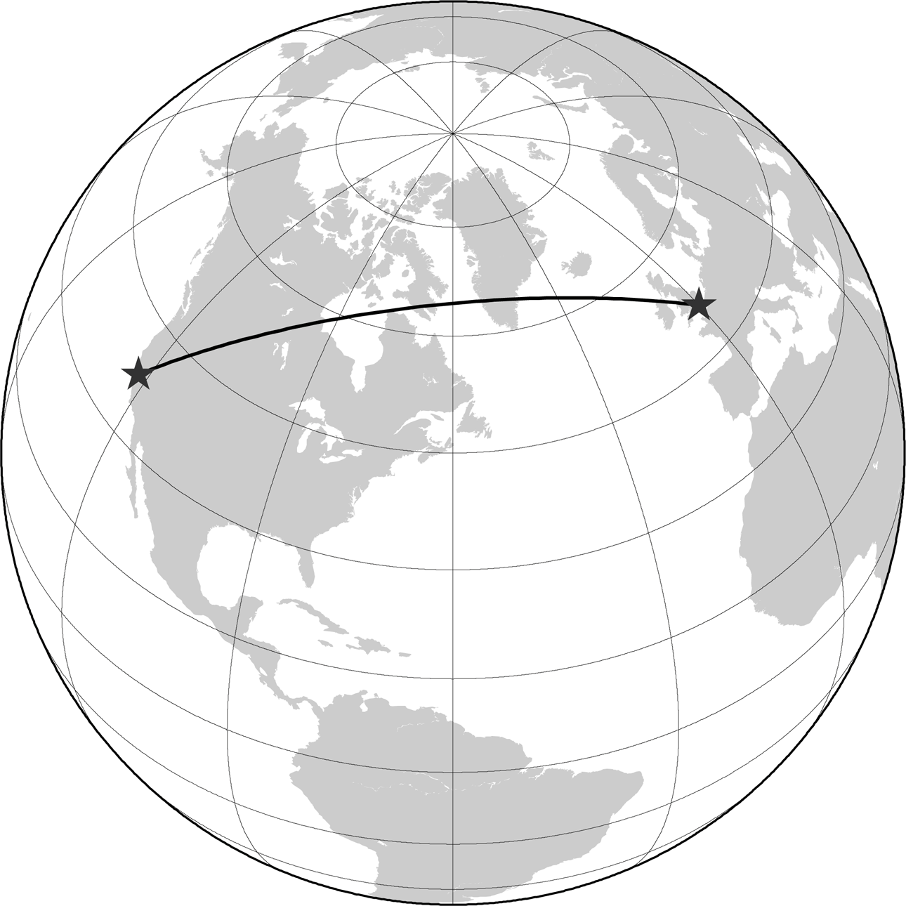
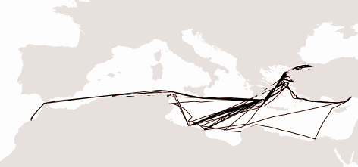
Building individual ship tracks
Track creation: - geographic filtering - great circle distances
Rasterization:
Merge by vessel type
Ship: PURKI
Country: Malta
IMO: 9004217
MMSI: 248495000
Callsign: 9HA2386 Length: 147m
Width: 26m
Type: cargo ship
Obs: 24225

Slide 29
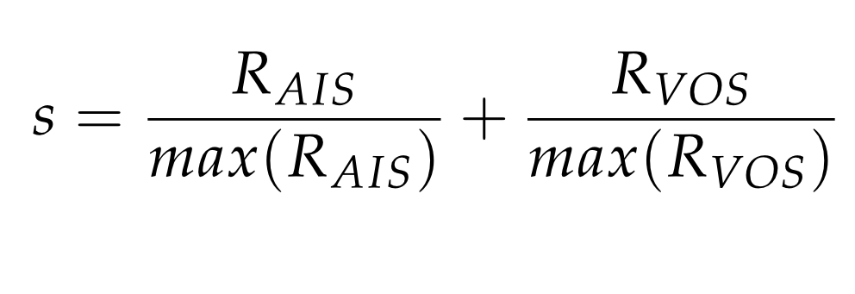
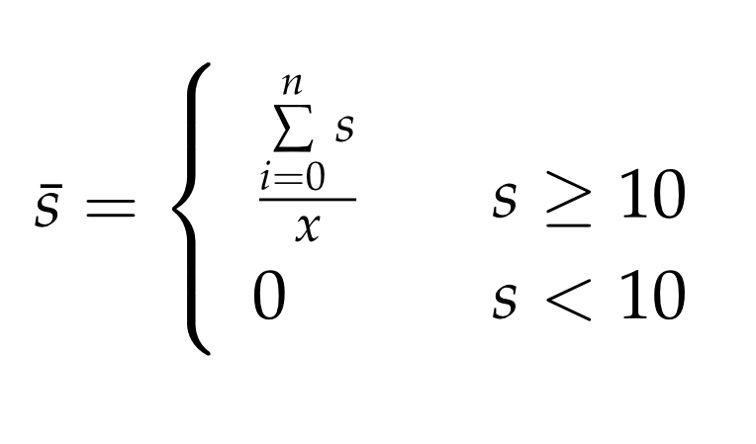
Initial views
Density function:
Speed:

Slide 31
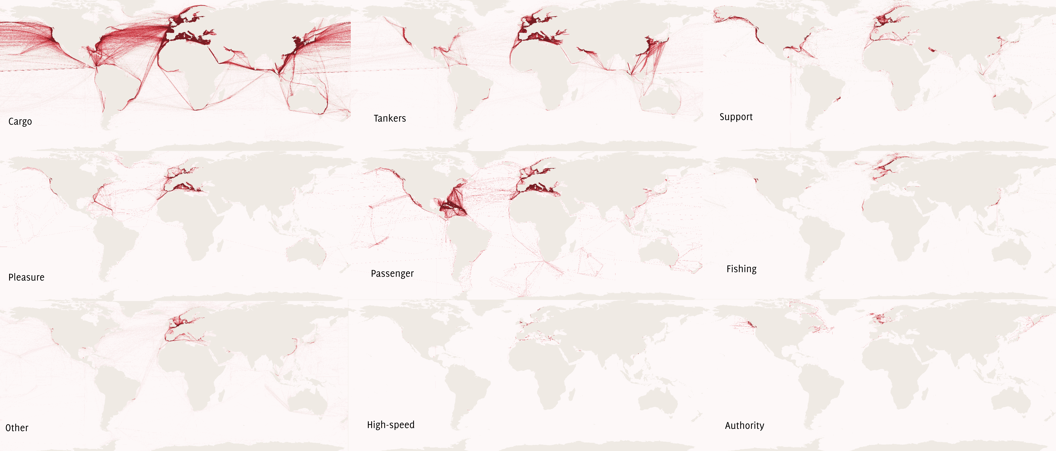
Vessel Densities by Type

Slide 32
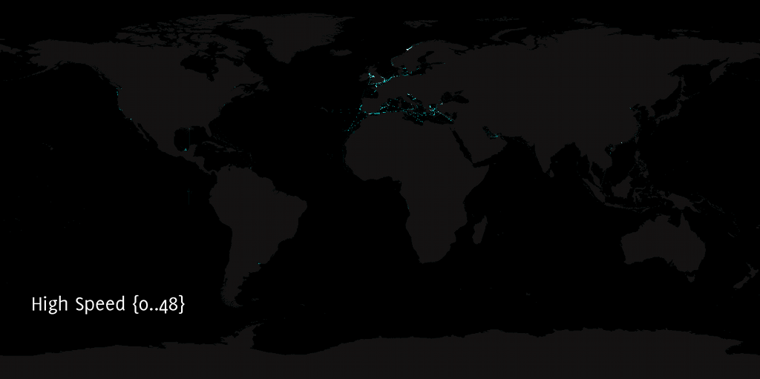

Slide 33
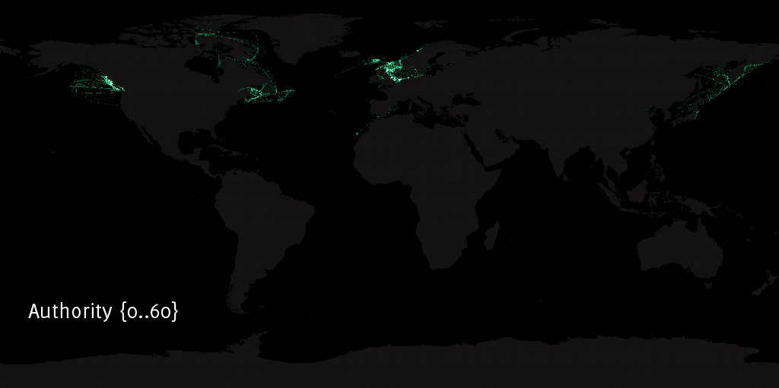

Slide 34
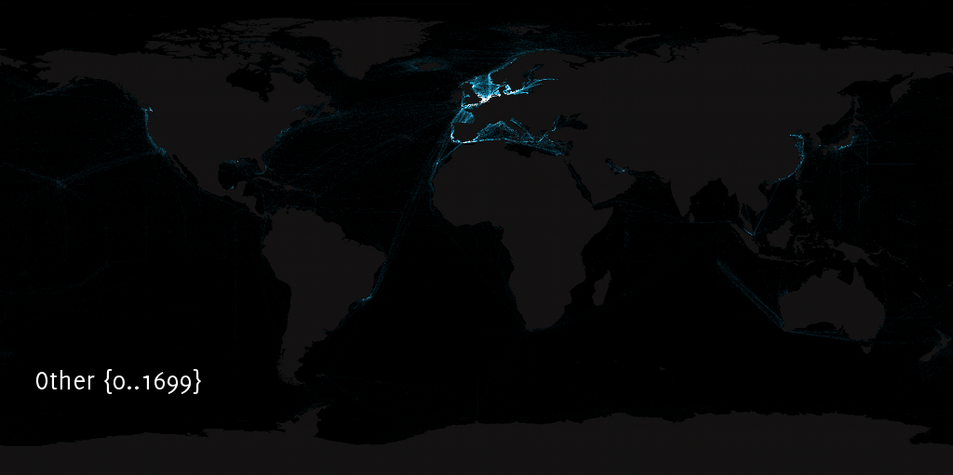

Slide 35
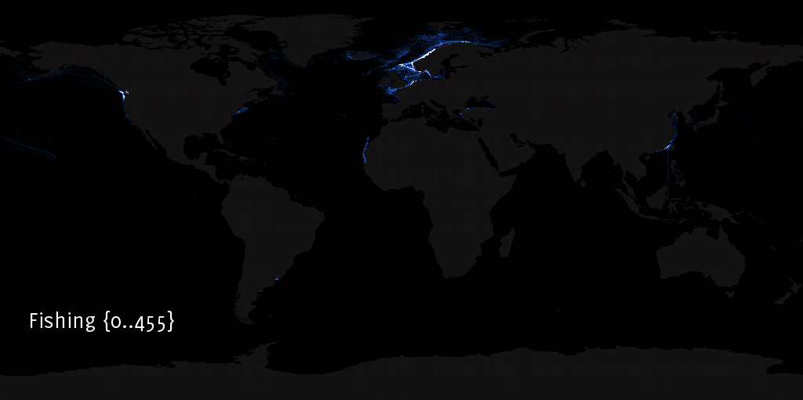

Slide 36
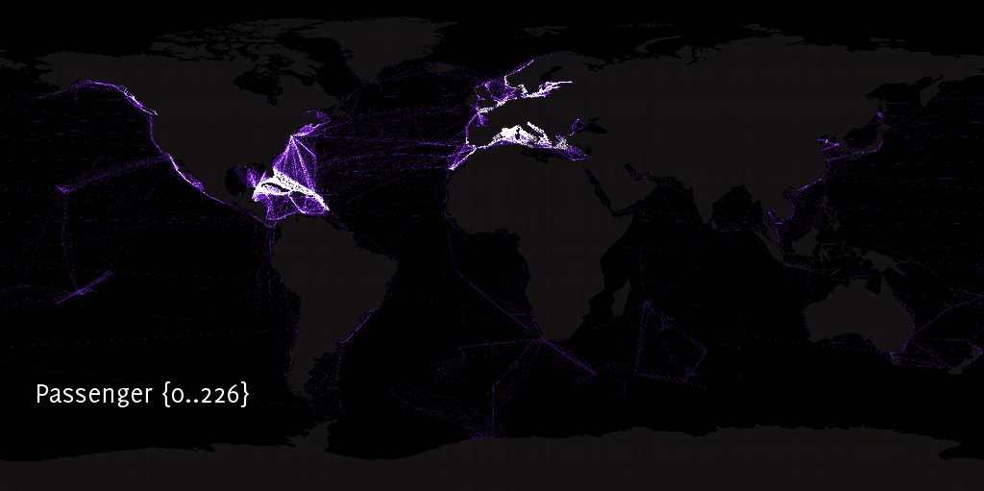

Slide 37
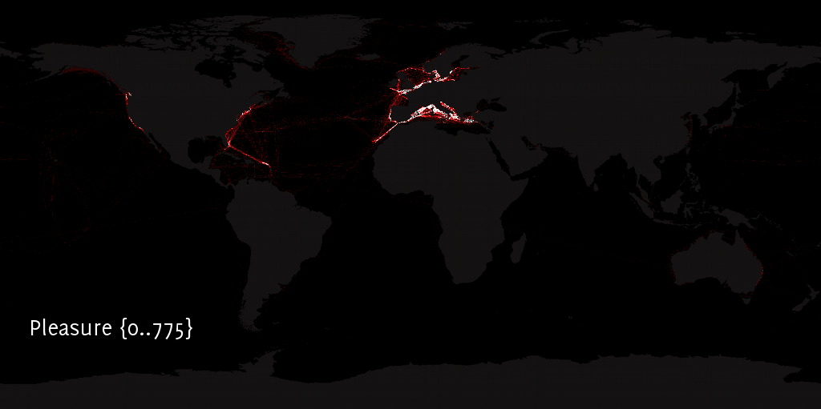

Slide 38
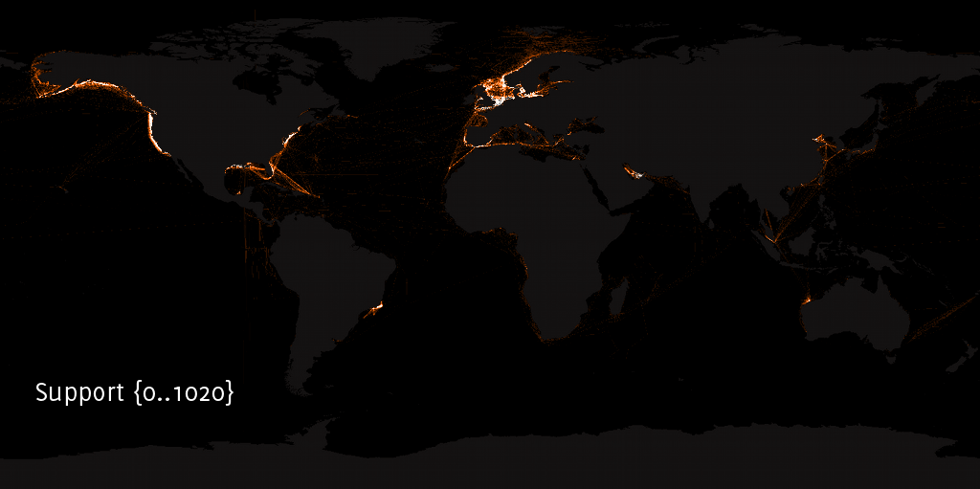

Slide 39
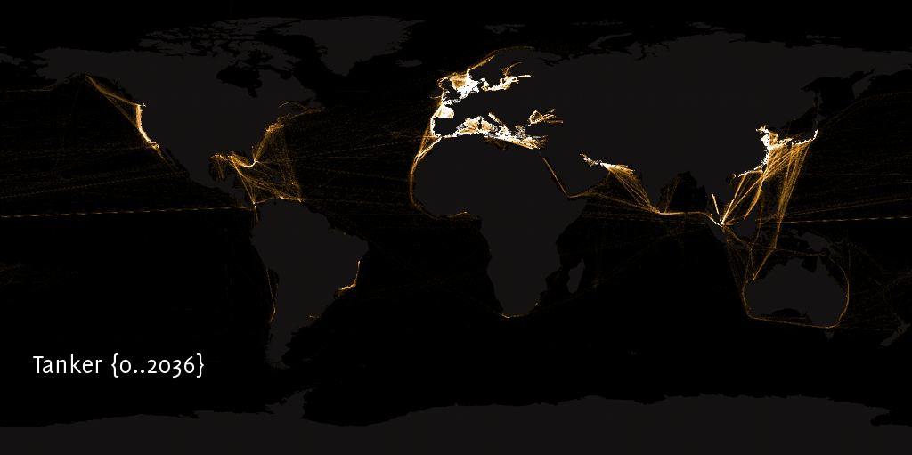

Slide 40
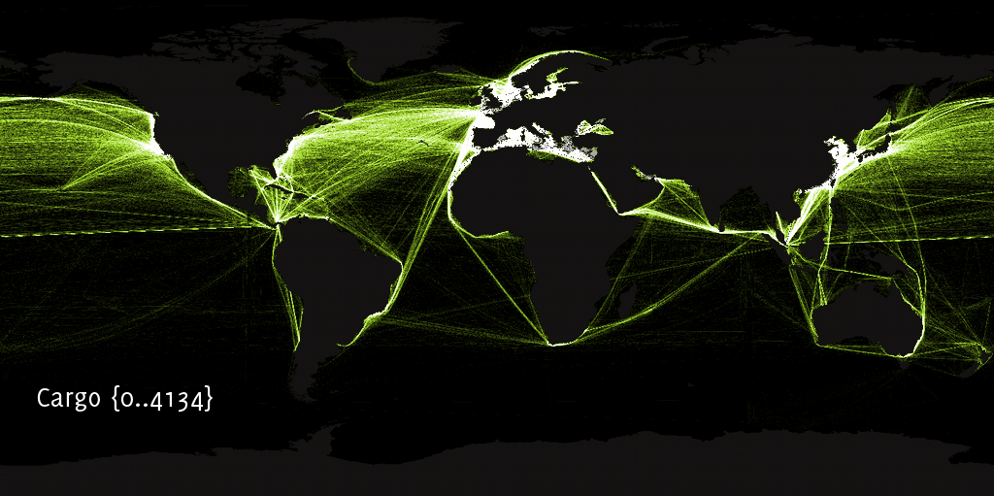

Slide 41
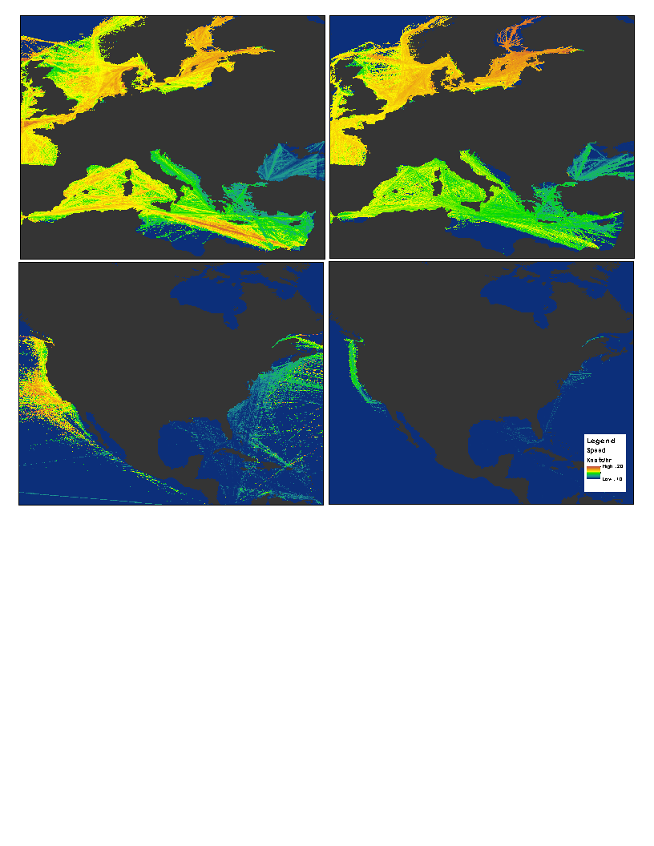
Cargo
Tanker
Cargo
Tanker

Slide 42
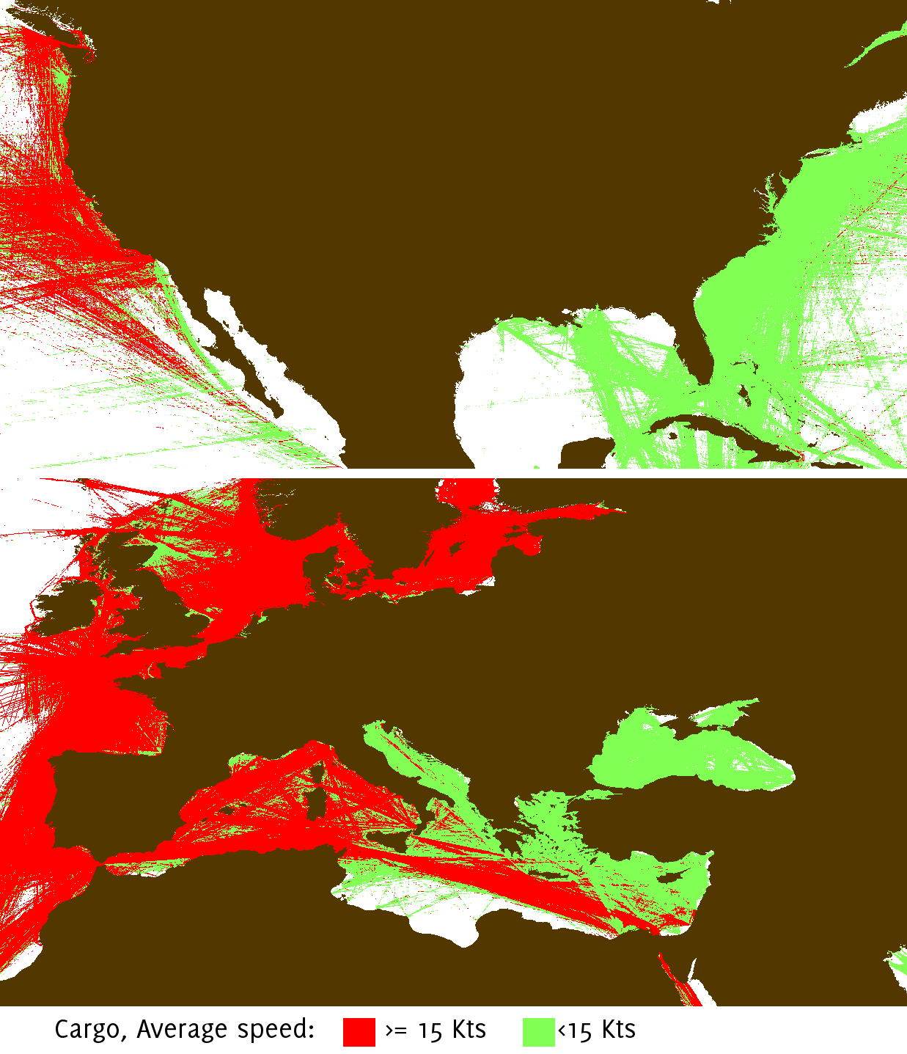
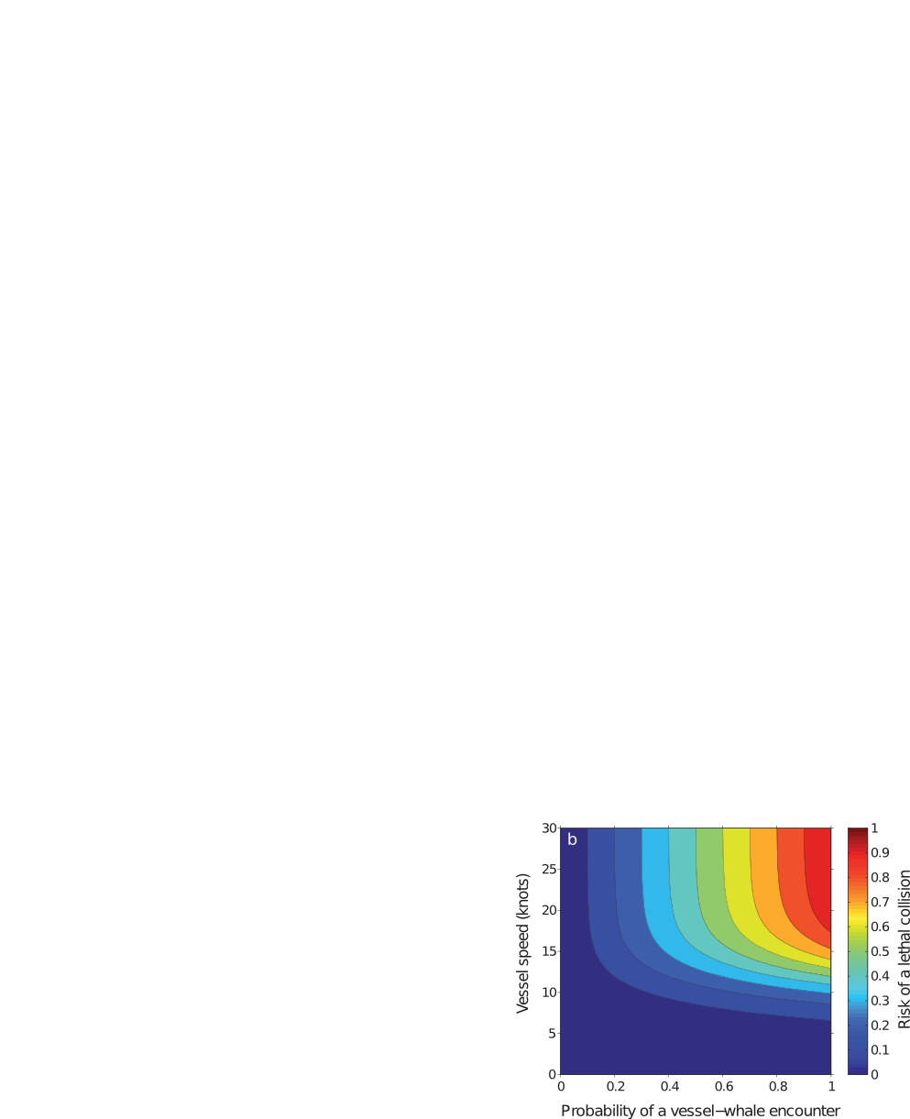
Ship Strikes
Vanderlaan et al. 2008

Slide 44
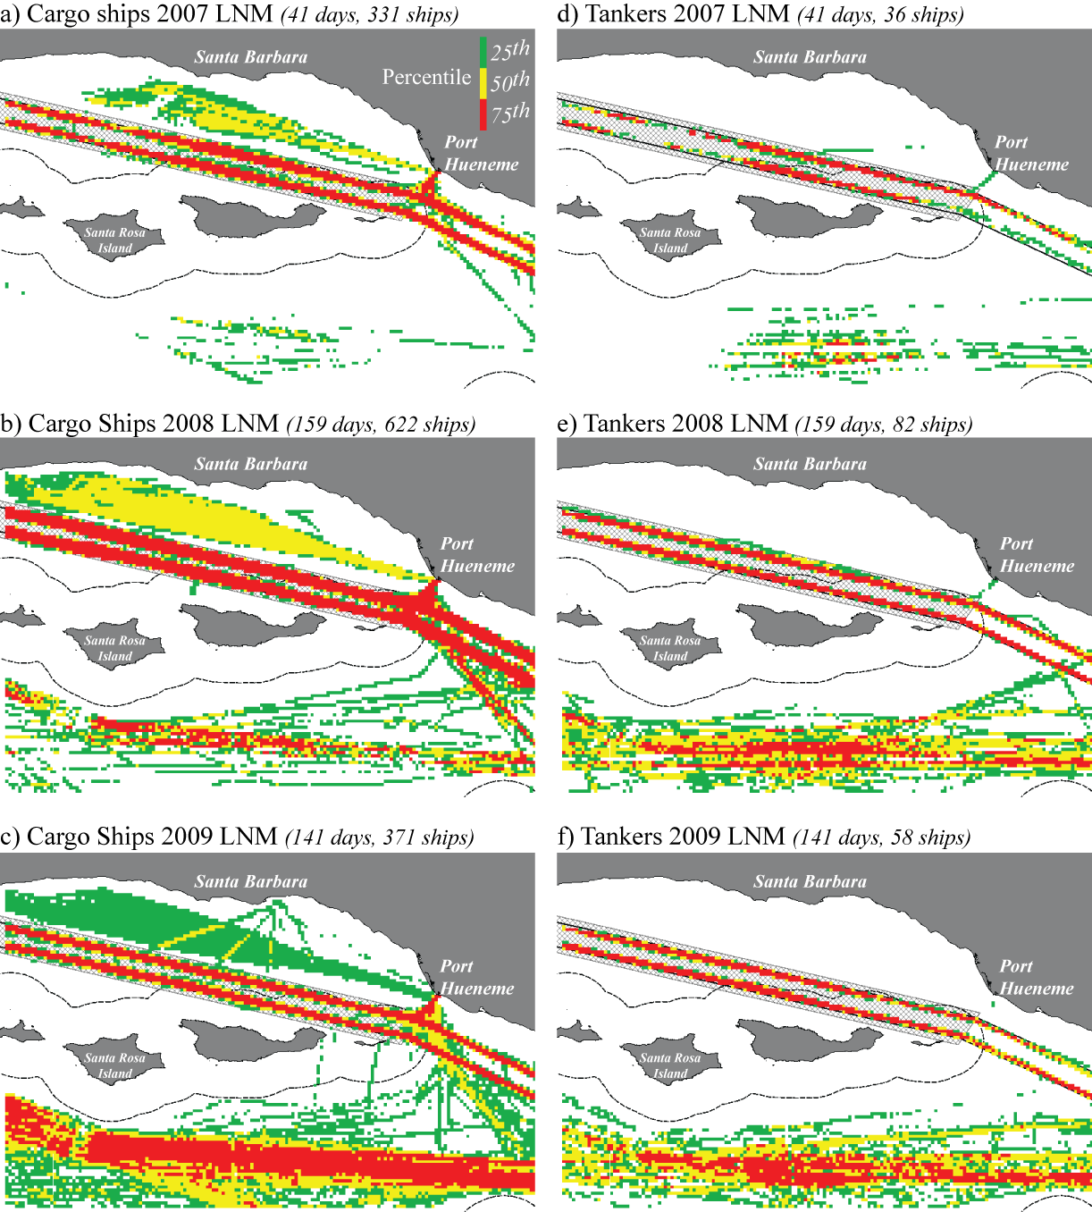

Slide 45
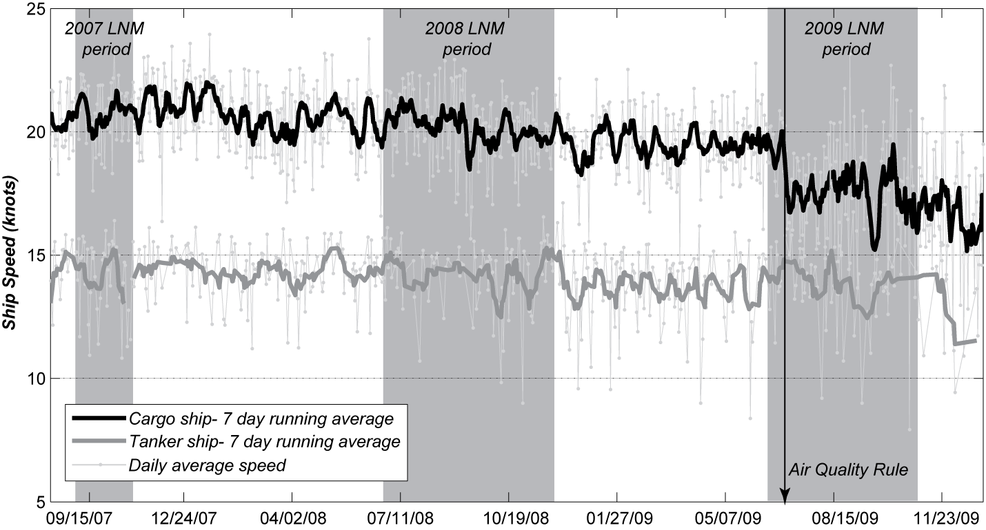
McKenna et al, 2012

Slide 46
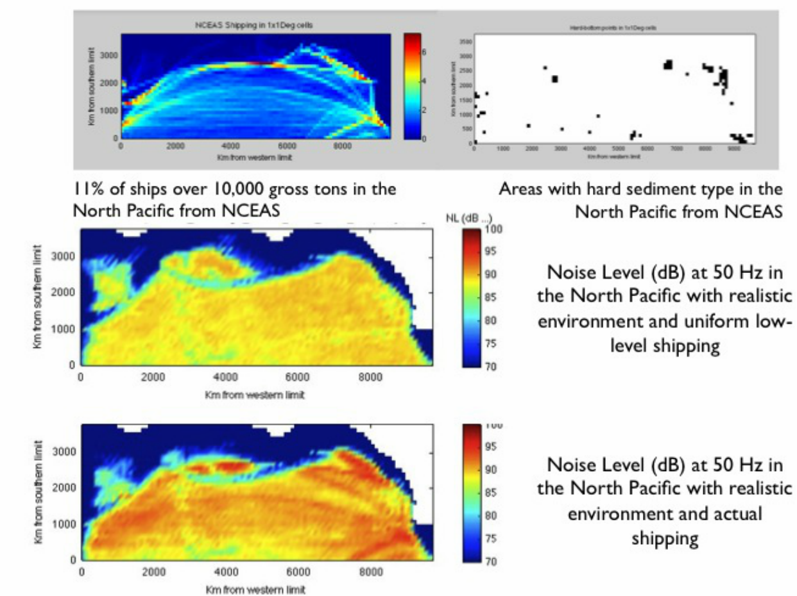
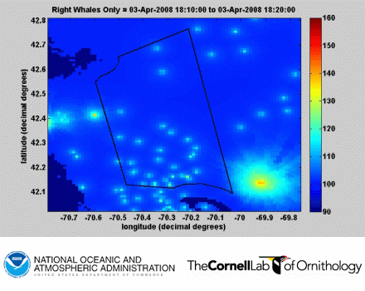
Noise Pollution: NOAA WG
NOAA, Cornell Ornithology

Slide 47
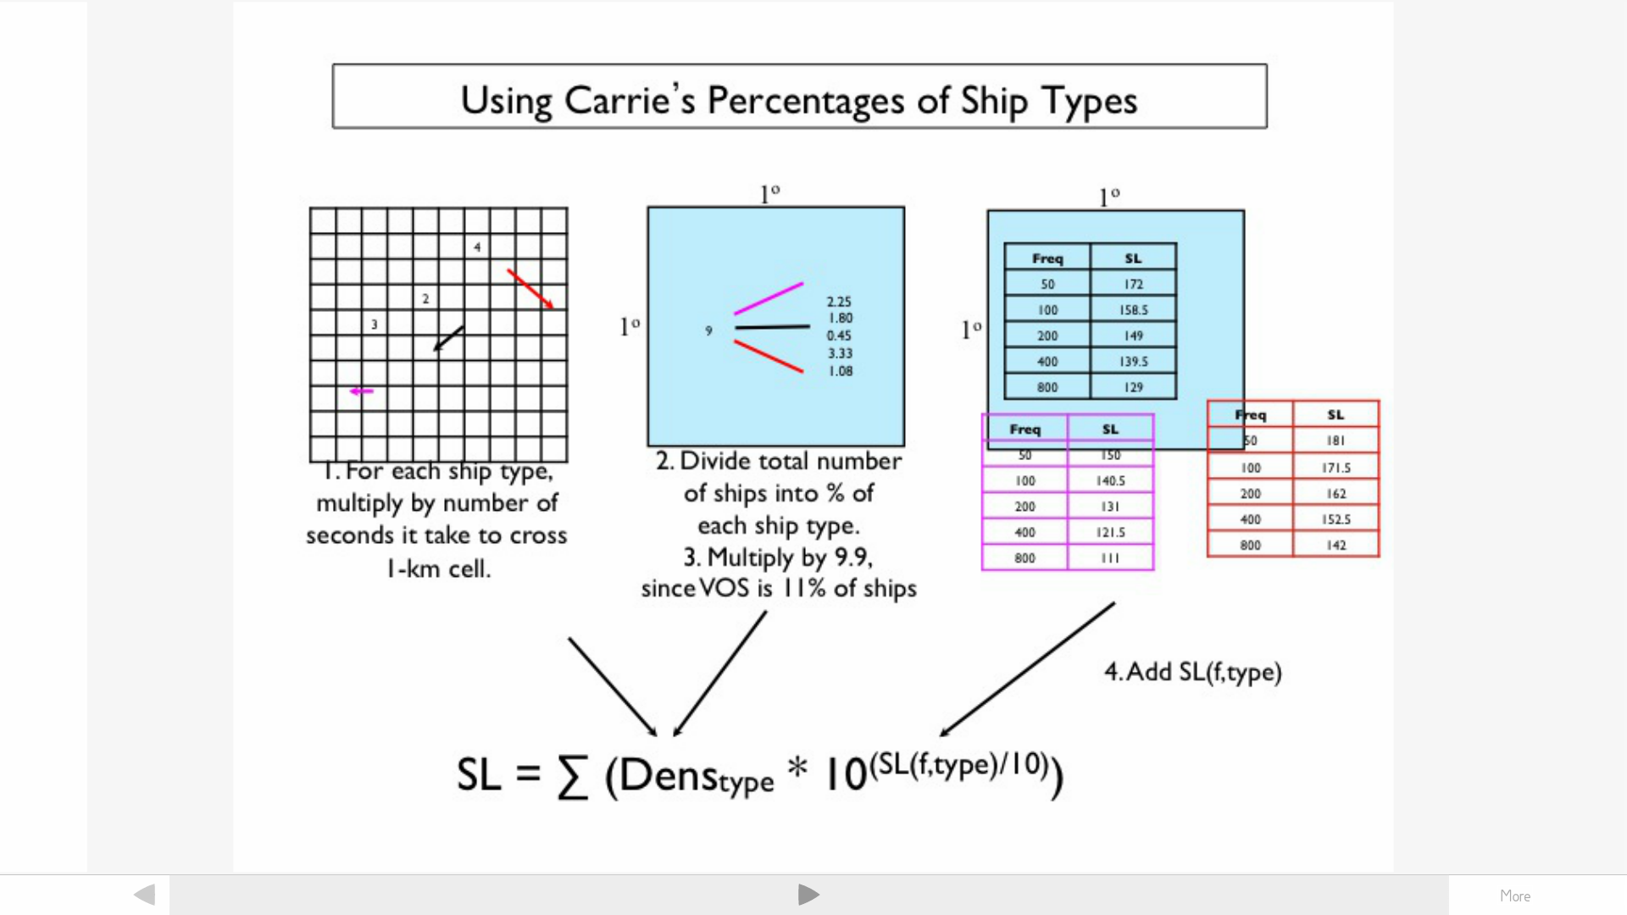
Noise Pollution: NOAA WG
Current model using VOS; next iteration will use the movement model discussed today

Slide 48
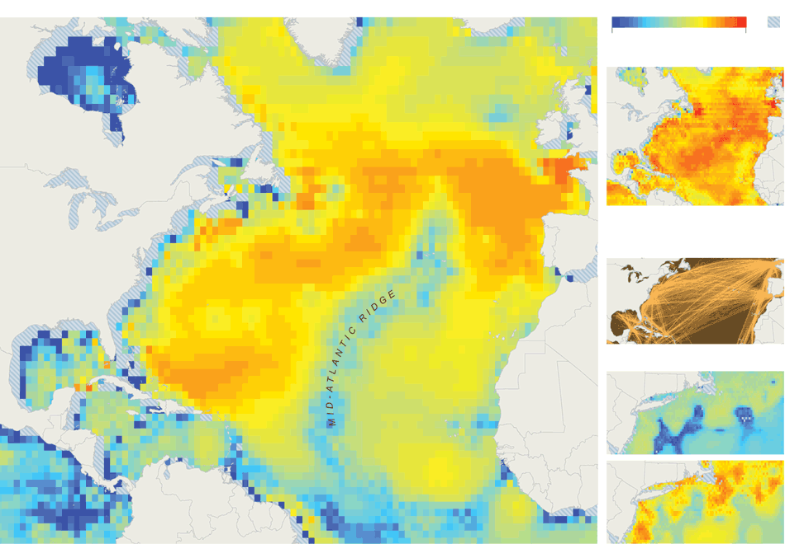
Noise Pollution: NOAA WG
New York Times, 2012-12-11 http://nyti.ms/UxKuqK

Slide 49
High Traffic Protected Areas
World Database on Protected Areas (WDPA): - 7481 Marine - Top 50 shown for traffic volume

Slide 50
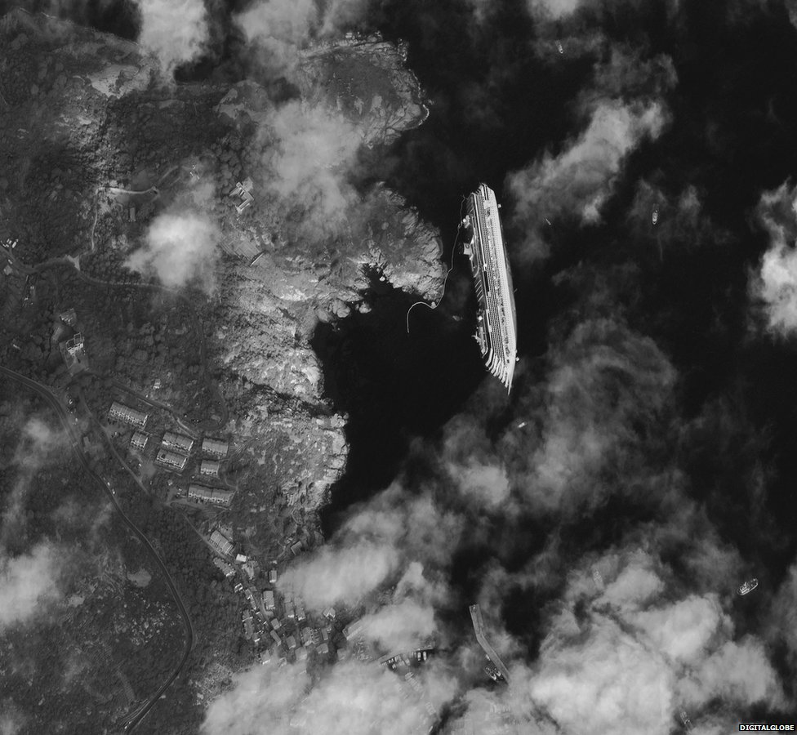
Ligurian Sea Sanctuary, 341d ago
Image Credit: DigitalGlobe
Notes:
Costa Concordia, wrecked in the largest Italian marine protected area Tuscan Archipelago Natural Park
Shipping is a core problem for effective marine spatial planning.

Slide 51
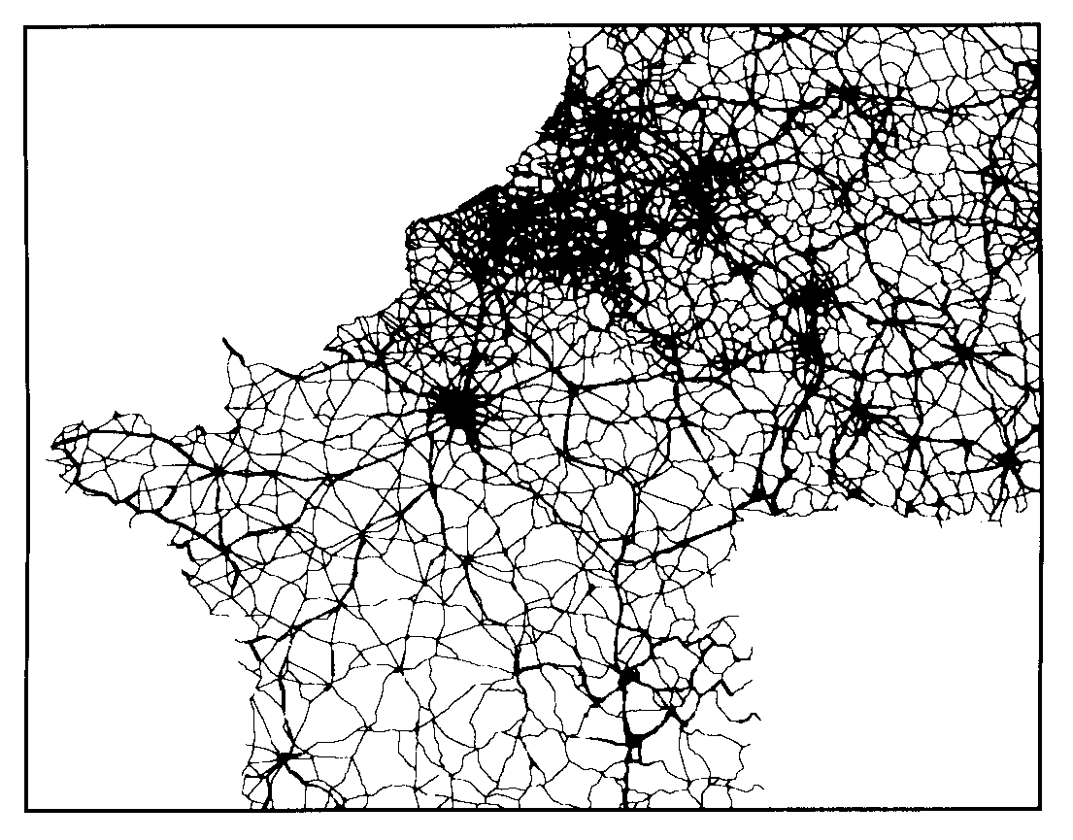
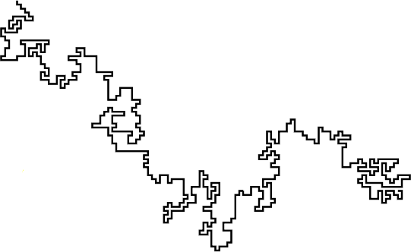
Future Work: Simplification
Many observations, can we simplify?
Extremes of movement models:
2D Random Walk
Constrained Network
Shipping: attributes of both
Notes:
Ships move freely through the ocean, but they have humans on board who want to get off places, which constrains them. To dig into our question of where the roads of the sea are, we need to model the ships more effectively.

Slide 52
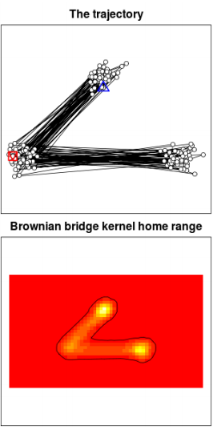
Movement models
Common in landscape ecology & geography
Predict distributions and trajectories from limited observations
Capture travel time and effort instead of assuming great circle distances

Slide 53
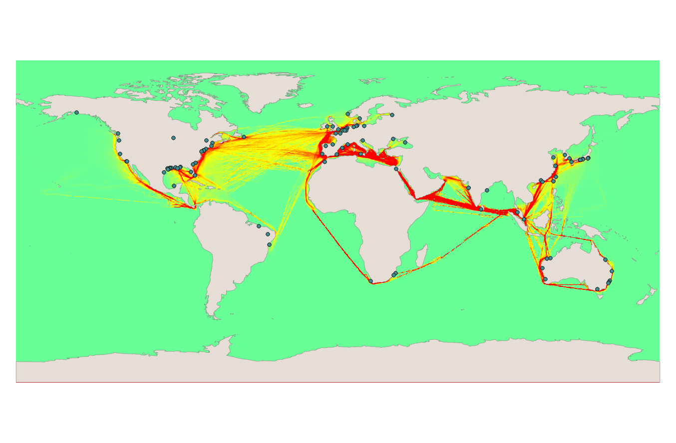
Circuit-based movement model

Slide 54

Notes:
Network model, port as endpoint nodes, junctions between routes as separate nodes. Allows us to dramatically reduce the complexity of the data while retaining a bunch of information which helps us answer some neat questions.

Slide 55

Shipping as a geographic network
Edges:
travel time ships traversed
economic cost environmental cost?
With global routes:
evaluate permutations
apply per-unit pricing based on ecological
knowledge

Slide 56

Thanks
NCEAS The Gaines Lab
Jennifer Balch, Ben Best,
Ben Halpern, Carrie Kappel,
Steve Katz, Megan McKenna, Jessica Phillips, Jai Ranganathan, Oliver Soong, Dawn Wright
Credit: Roger Freedman, UCSB

